Slide 1
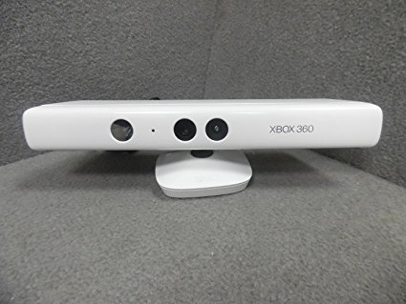
Project for Gesture Based UI Development
Garret Tonra
&
Alan Heanue

Slide 2
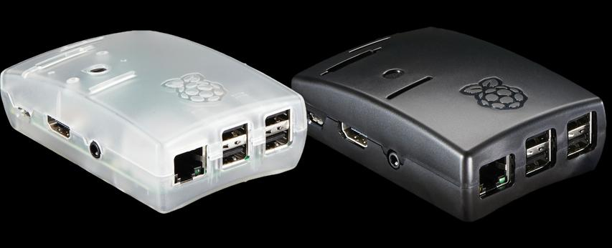
Languages
Java
JavaScript
Tools Used
Breadboard circuit
Arduino
Leap Motion

Slide 3
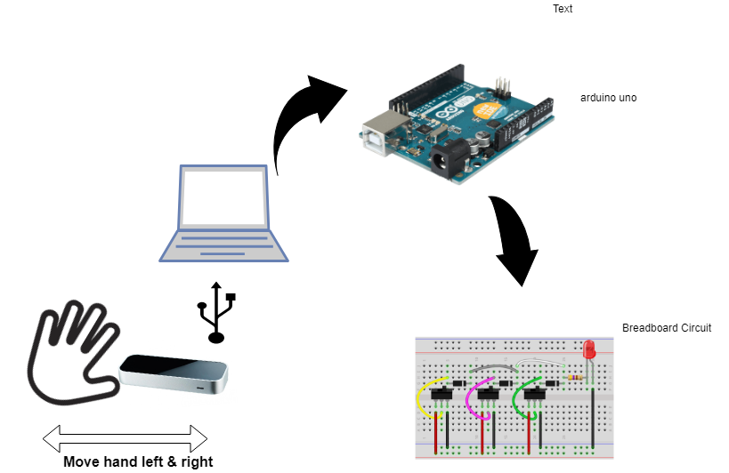
Archticture

Slide 4
TimeLine
Feb
Mar
Apr
Planning & Ideas
Building Project
Final touches and execution
Ideas and planning what to develop
Downloading SDK, Configuring Raspberry pi and putting it altogether
Putting all working parts together and presenting the project and documentation

